Slide 1
Python Threads

Slide 2
What Are Threads
Thread: The operating system object that executes the instructions of a process.
When we run a Python script, it starts an instance of the Python interpreter that runs our code in the main thread. The main thread is the default thread of a Python process.

Slide 3
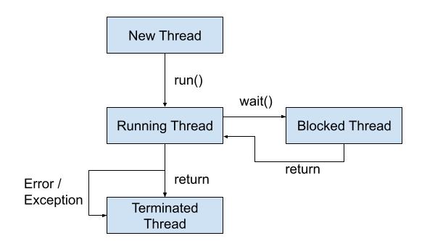
Life-Cycle of a Thread
A thread in Python is represented as an instance of the threading.Thread class.
New Thread.
Running Thread.
Blocked Thread (optional).
Terminated Thread.

Slide 4
How to Run a Function In a Thread
Create an instance of the threading.Thread class.
Specify the name of the function via the “target” argument.
Call the start() function.

Slide 5
# example of running a function in another thread
from time import sleep
from threading import Thread
# a custom function that blocks for a moment
def task():
# block for a moment
sleep(1)
# display a message
print('This is from another thread')
# create a thread
thread = Thread(target=task)
# run the thread
thread.start()
# wait for the thread to finish
print('Waiting for the thread...')
thread.join()

Slide 6
Creating multiple Thread
from time import sleep
from threading import Thread
# a custom function that blocks for a moment
def task1(sleep_time, message):
# block for a moment
# display a message
for i in range(10):
sleep(sleep_time)
print("Thread1: "+message,i)
def task2(sleep_time, message):
# block for a moment
# display a message
for i in range(10):
sleep(sleep_time)
print("Thread2: "+message,i)
# create a thread
thread1 = Thread(target=task1, args=(1.5, 'Hello'))
thread2 = Thread(target=task2, args=(3, 'Hi'))
# run the thread
thread1.start()
thread2.start()
# wait for the thread to finish
print('Waiting for the thread...')
thread1.join()
thread2.join()
print('Thread completed')

Slide 7
Running a Function in a Thread With Arguments
# example of running a function with arguments in another thread
from time import sleep
from threading import Thread
# a custom function that blocks for a moment
def task(sleep_time, message):
# block for a moment
sleep(sleep_time)
# display a message
print(message)
# create a thread
thread = Thread(target=task, args=(1.5, 'New message from another thread'))
# run the thread
thread.start()
# wait for the thread to finish
print('Waiting for the thread...')
thread.join()

Slide 8
Custom thread
# example of extending the Thread class
from time import sleep
from threading import Thread
# custom thread class
class CustomThread(Thread):
# override the run function
def run(self):
# block for a moment
sleep(1)
# display a message
print('This is coming from another thread')
# create the thread
thread = CustomThread()
# start the thread
thread.start()
# wait for the thread to finish
print('Waiting for the thread to finish')
thread.join()

Slide 9
Extending the Thread Class and Returning Values
# example of extending the Thread class and return values
from time import sleep
from threading import Thread
# custom thread class
class CustomThread(Thread):
# override the run function
def run(self):
# block for a moment
sleep(1)
# display a message
print('This is coming from another thread')
# store return value
self.value = 99
# create the thread
thread = CustomThread()
# start the thread
thread.start()
# wait for the thread to finish
print('Waiting for the thread to finish')
thread.join()
# get the value returned from run
value = thread.value
print(f'Got: {value}')

Slide 10
Problem Statement
Create a simple program to sum of prime numbers from 2-1million. Find time to perform this operation.
Create four threads to divide this task into four parts. One thread 2- quarter million then another thread quarter to half and so on. Then find the time to perform the task.

Slide 11
Problem Statement 2
Write a program to read file content of multiple file present in folder named as 1.txt, 2.txt ……12.txt. Calculate time for performing this operation.
Write a program using four thread to read files from same folder. First thread will read 1- 3.txt then second 4-6.txt and so on. Calculate time to read the files.

Slide 12
Global Interpreter Lock
only one thread can execute Python code at once

Slide 13
Thread Name
# example of accessing the thread name
from threading import Thread
# create the thread
thread = Thread()
# report the thread name
print(thread.name)
# example of setting the thread name in the constructor
from threading import Thread
# create a thread with a custom name
thread = Thread(name='MyThread')
# report thread name
print(thread.name)
# example of setting the thread name via the property
from threading import Thread
# create a thread
thread = Thread()
# set the name
thread.name = 'MyThread'
# report thread name
print(thread.name)

Slide 14
Thread Daemon
A daemon thread is a background thread.
The ideas is that backgrounds are like “daemons” or spirits (from the ancient Greek) that do tasks for you in the background.
# example of setting a thread to be a daemon via the property
from threading import Thread
# create a thread
thread = Thread()
# configure the thread to be a daemon
thread.daemon = True
# report if the thread is a daemon
print(thread.daemon)
# example of setting a thread to be a daemon via the constructor
from threading import Thread
# create a daemon thread
thread = Thread(daemon=True)
# report if the thread is a daemon
print(thread.daemon)

Slide 15
thread.is_alive(): check if a Thread is alive
# example of assessing whether a running thread is alive from time import sleep from threading import Thread # create the thread thread = Thread(target=lambda:sleep(1)) # report the thread is alive print(thread.is_alive()) # start the thread thread.start() # report the thread is alive print(thread.is_alive()) # wait for the thread to finish thread.join() # report the thread is alive print(thread.is_alive())

Slide 16
Thread Identifier
# example of reporting the thread identifier
from threading import Thread
# create the thread
thread = Thread()
# report the thread identifier
print(thread.ident)
# start the thread
thread.start()
# report the thread identifier
print(thread.ident)

